Slide 1
Localization in React Native Expo
By Ephrem Shiferaw Ewnetu
Kaisa otterklau

Slide 2
What is Localization?
Localizing an app means building it to support multiple languages and regions, making the app accessible and usable to a wider range of users.
In mobile app development, localization gets the language and locale from a user’s device — which is not the same as a user’s geolocation — and writes the software to adapt accordingly.

Slide 3

Why Localization
-50% of all queries on Google are in languages other than English.
-7 of the 10 top markets by iOS downloads and 9 of the 10 top markets by Google Play downloads are non-native English markets.
-Nearly 75% of Internet users prefer to read product information in their native language.

Slide 4
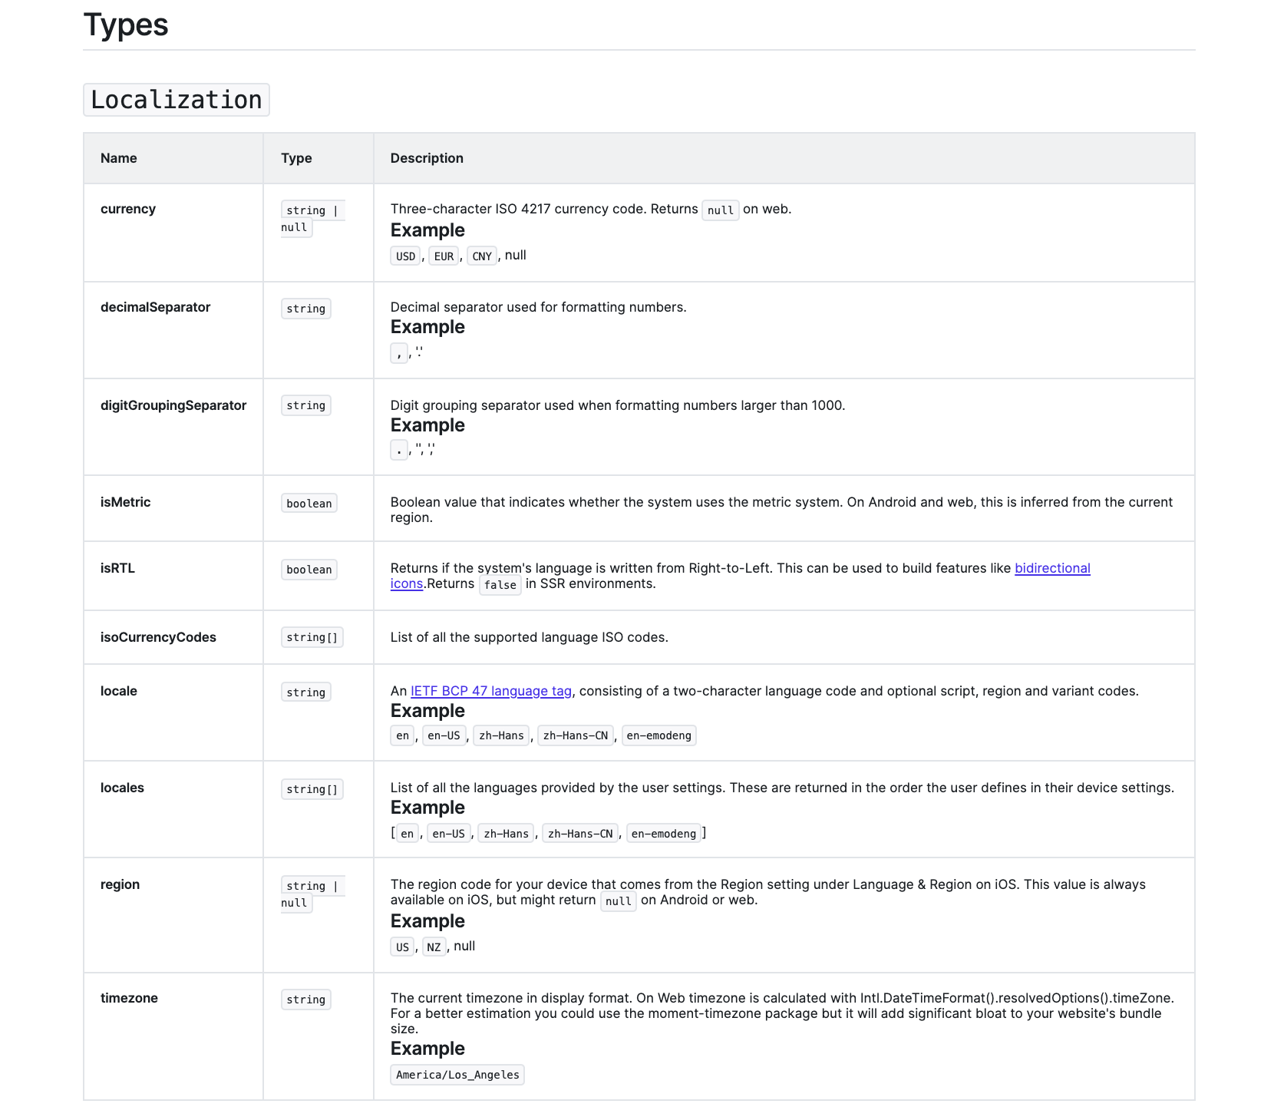

Slide 5


Installation and Usage
import * as Localization from ‘expo-localization';
import i18n from 'i18n-js';
// Set the key-value pairs for the different languages you want to support.
i18n.translations = {
en: { welcome: 'Hello' },
ja: { welcome: 'こんにちは' },
};
// Set the locale once at the beginning of your app.
i18n.locale = Localization.locale;

Slide 6



Slide 7
Sources
https://docs.expo.dev/versions/v42.0.0/sdk/localization/
https://lokalise.com/blog/react-native-localization/
https://blog.logrocket.com/internationalization-and-localization-in-react-native/

Slide 8
Thank you!
Kiitos!
Gracias!

